Slide 1
ندوة الصناعات التحويلية للفوسفات الاردني: الواقع والتحديات ودورها في دعم الاقتصاد الوطني – عمان -7 / 7 / 2025
Phosphate in Clean Energy Applications
Prof. Dr. Khalil Khader
Department of Earth and Environmental Sciences
Prince El Hassan Bin Talal Faculty of Natural Resources and Environment, The Hashemite University
Amman – 7/7/2025

Slide 2
What are phosphorus and phosphate rock?
 “An element of life and thought”, phosphorus is an essential element of life on the Earth.
 Phosphorus is one of the three macronutrients used in largest quantities by plants (NPK), and it has no substitute.
 It is also used to manufacture feed additives and some industrial products, including the fast-rising market of lithium iron phosphate (LFP) batteries for electric vehicles.

Slide 3
Phosphate Resource Forms
 There are three main forms of phosphate deposits:
Sedimentary marine phosphorite (75%)
Igneous apatite (25%)
Guano (negligible)
 The grade and quality of a deposit is important to consider because it determines its suitability and costs of processing.

Slide 4
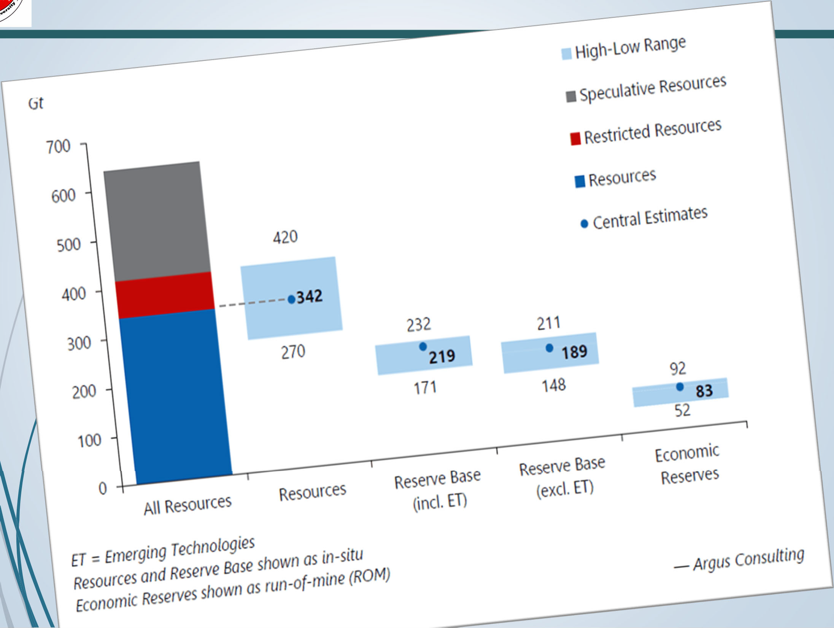
Global Phosphate Resource

Slide 5
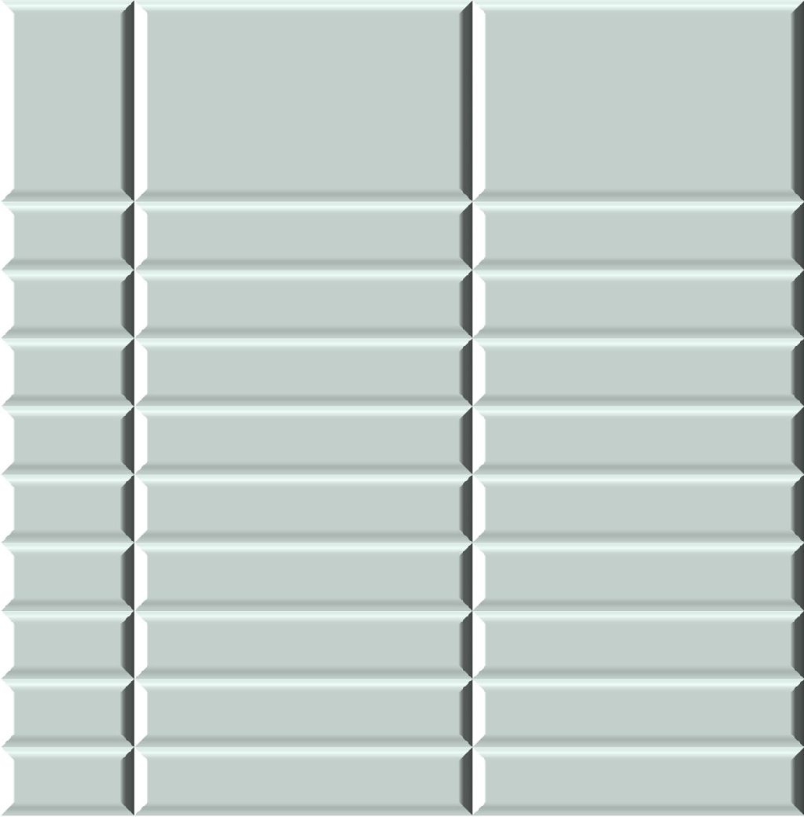

Phosphate Production and Reserve
 |  | Annual Mine
Rank | Country | Production
 |  | Mt
1 | China | 90,000
2 | Morocco | 35,000
3 | USA | 19,800
4 | Russia | 14,000
5 | Jordan | 12,000
6 | KSA | 8,500
8 | Egypt | 4,800
9 | Tunisia | 3,600
11 | Algeria | 1,800
Rank Country
Australia
Morocco
China
Egypt
Tunisia
Russia
Algeria
10 KSA
13 Jordan
Reserves Mt 51,100,000
50,000,000
3,800,000
2,800,000
2,500,000
2,400,000
2,200,000
1,400,000
1,000,000

Slide 6
Phosphate Future Demand
World phosphate fertilizer
consumption is
between 42 & 49 Mt P₂O₅ between 2010 and 2020 according to IFASTAT.
IFA further projected that world phosphate fertilizer demand would increase to 63-72 Mt by 2050.
Accounting for non-fertilizer uses and processing, the annual phosphate rock production requirements is between 78 & 100 Mt in 2050.

Slide 7
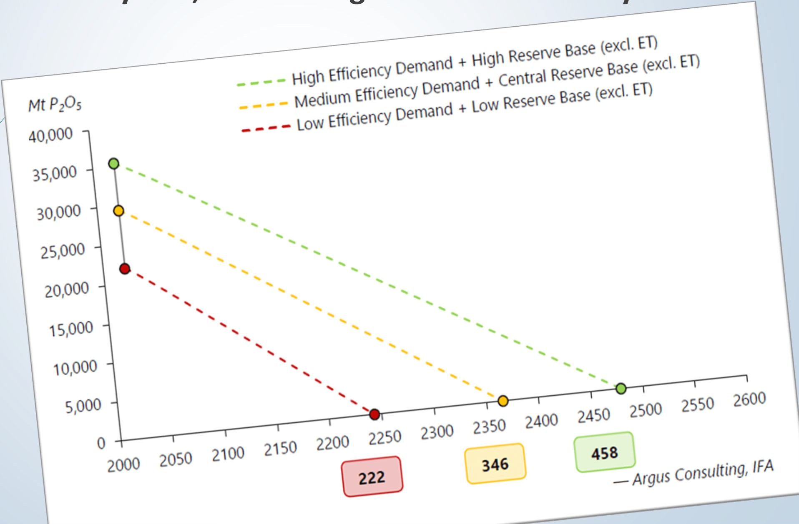
Phosphate Resource Future Demand
 Combining the central reserve base estimate with the medium efficiency demand scenario leads to a calculated lifespan of 346 years, with a range from 222 to 458 years.

Slide 8
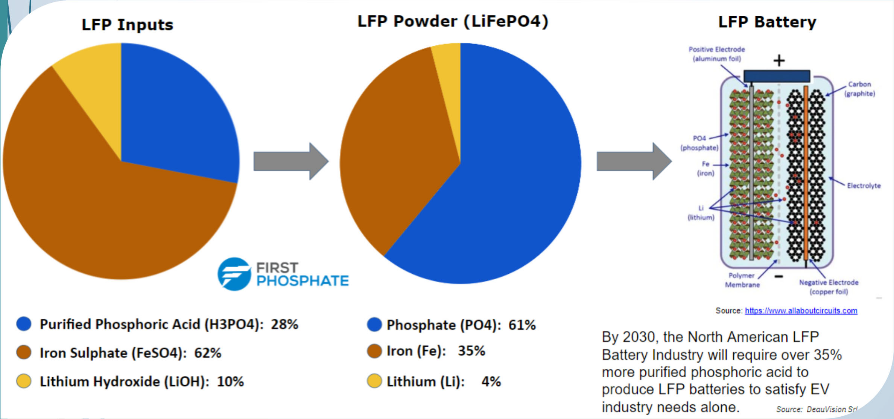

I. Application in Lithium Iron Phosphate (LFP) Batteries
 LFP batteries use lithium iron phosphate (LiFePO₄) as the cathode material alongside a graphite carbon electrode with a metallic backing as the anode.

Slide 9
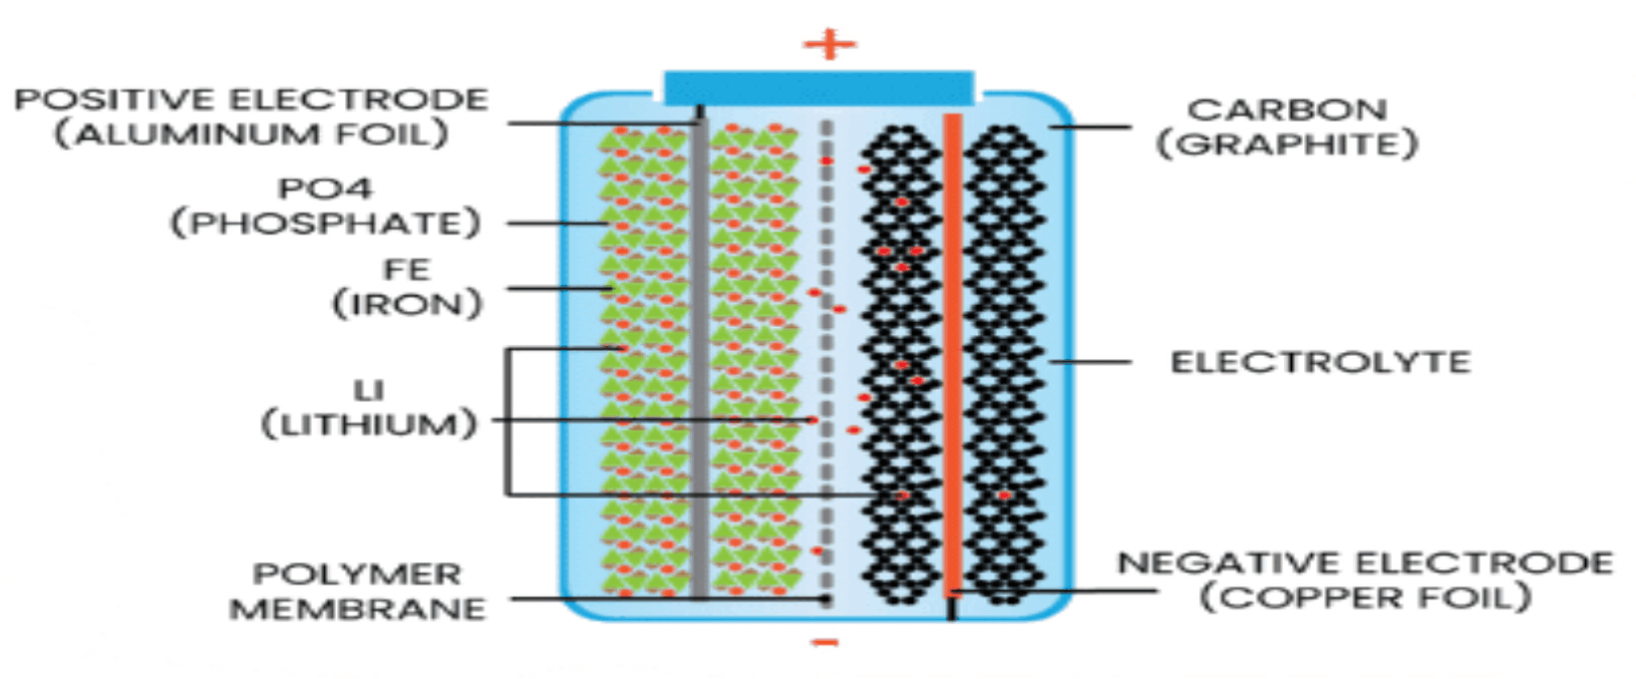
I. Application in Lithium Iron Phosphate (LFP) Batteries
Advantages
High energy density.
Long lifespan.
Low cost.
Long cycle life.
High safety.
Low maintenance.
Low toxicity.
LFP batteries can deliver constant voltage at a higher charge cycle.

Slide 10
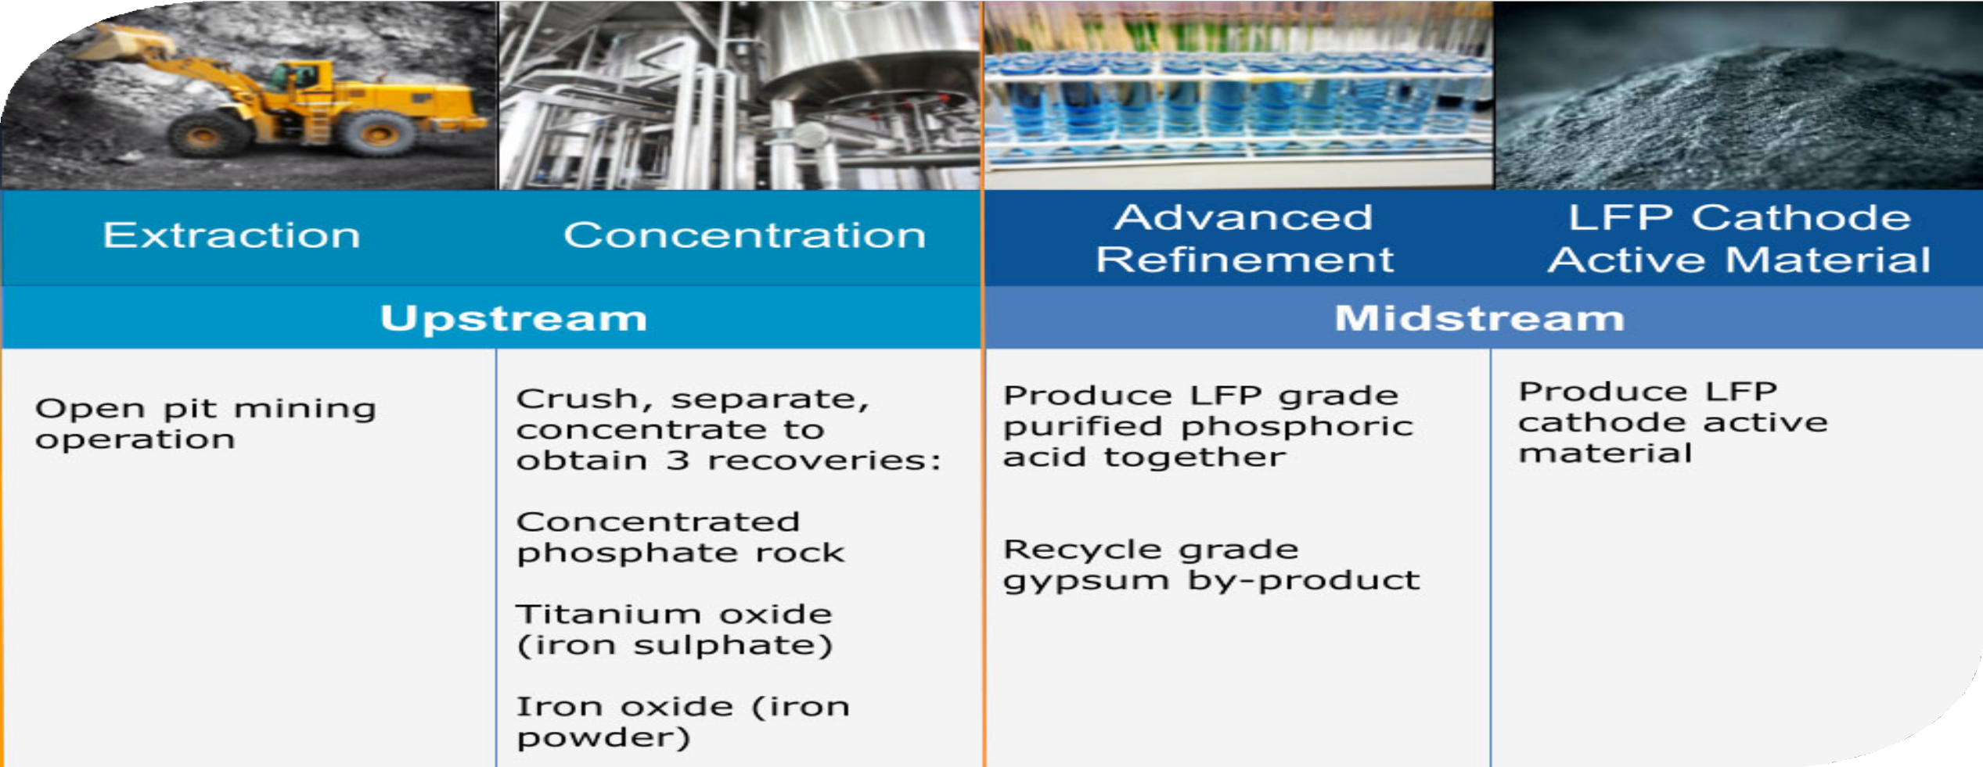
I. Application in Lithium Iron Phosphate (LFP) Batteries

Slide 11
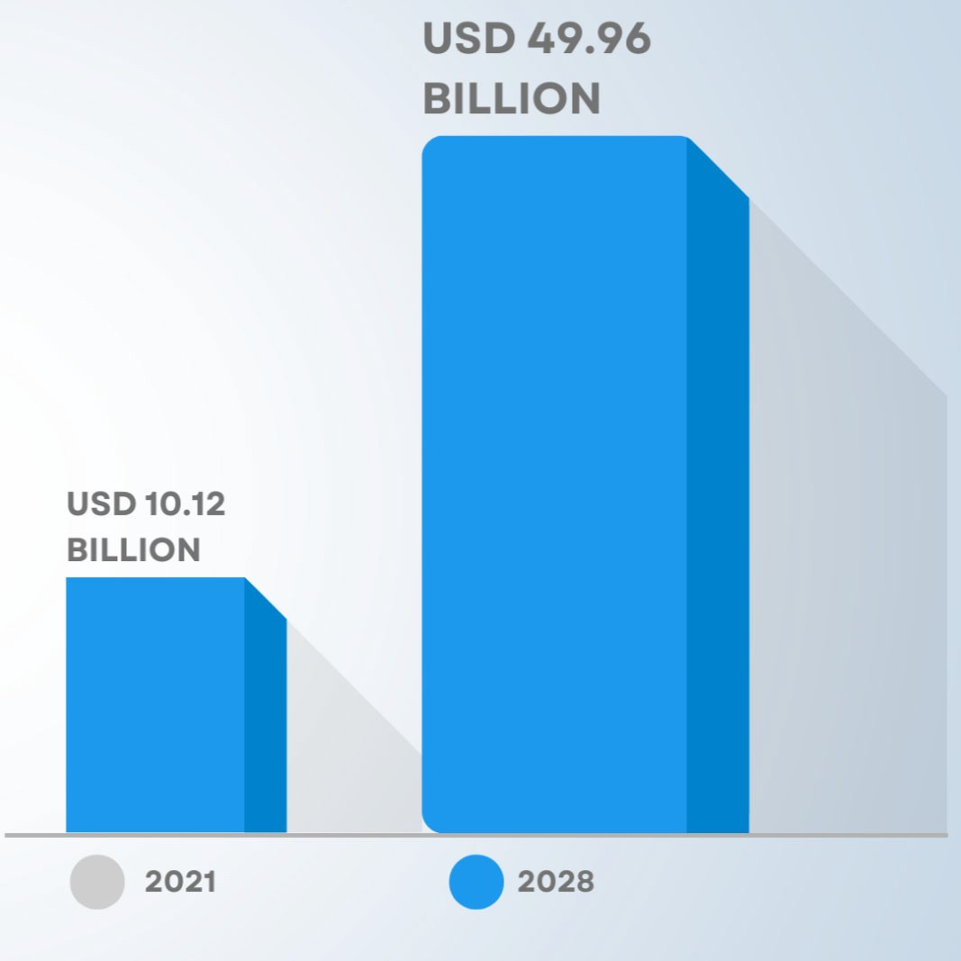

Use of LFP Batteries
 LFP batteries are emerging as a popular choice for solar storage
 LFP batteries are finding
several roles
in vehicle use,
utility-scale stationary applications,
backup power.

Slide 12
Use of LFP Batteries
 As of September 2022, LFP type battery market share for EVs reached 31%, and of that, 68% was from Tesla and
Chinese EV maker BYD
production alone.
 LFP type production is expected
to rise further and exceeds lithium nickel manganese cobalt oxides (NMC) type batteries in 2028.

Slide 13
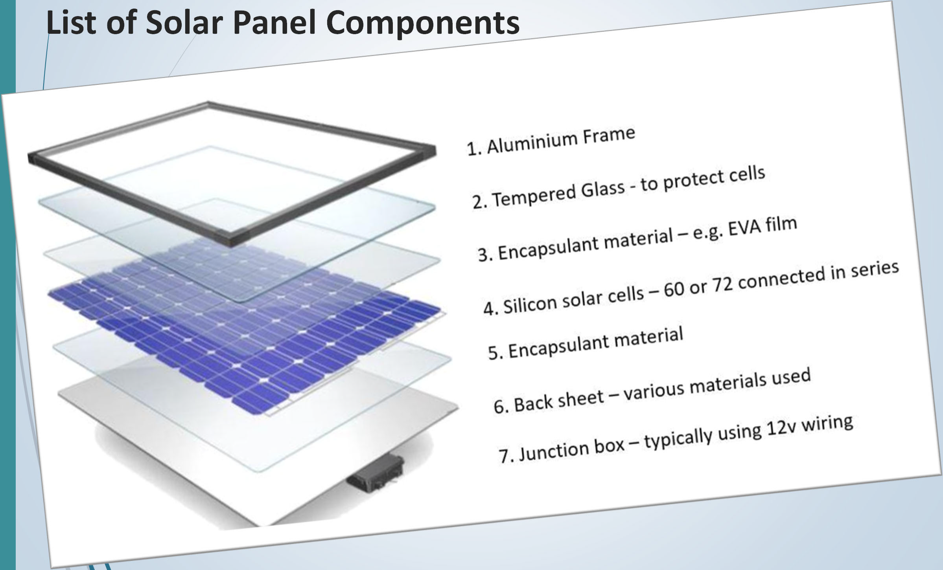
II. Application in Solar Panels
List of Solar Panel Components

Slide 14
Role of Phosphorus in Solar Panels
 Phosphorus is essential in creating N-type semiconductor materials used in solar panels and various electronic devices.
 It is commonly used to create the N-type layer in silicon solar cells.
 In N-type silicon solar panels phosphorus atoms are introduced to create an excess of electrons contributing to the semiconductor's negative charge carriers.
 These extra electrons facilitate the movement of electrical current in solar cells which is necessary for the photovoltaic effect to generate electricity from sunlight.

Slide 15
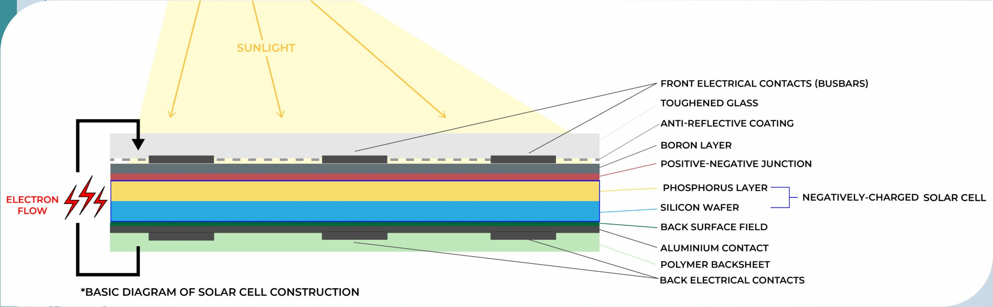
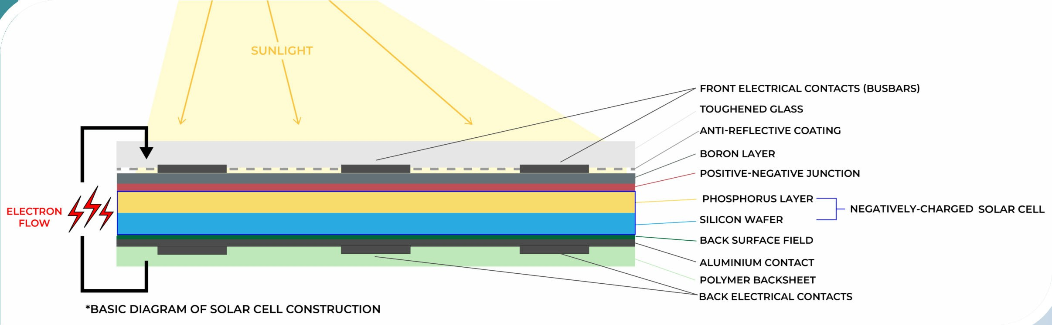
Role of Phosphorus in Solar Panels
 The silicon (Si) used in solar panels to improve the quantity of available electrons.
 Phosphorus (P) and boron (B) are bonded to opposing layers of silicon.
 P adds additional available electrons and provides a negative charge.

Slide 16
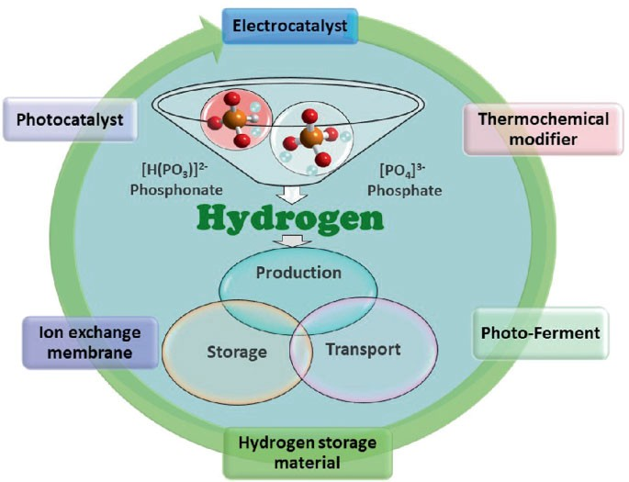
III. Phosphorus in Hydrogen Production

Slide 17
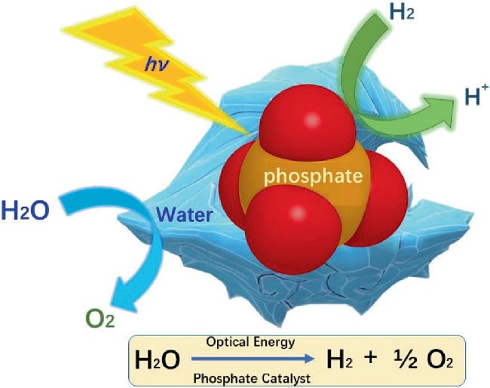
III. Phosphorus in Hydrogen Production
 Phosphates can act as catalysts in hydrogen production through various mechanisms:
Promoting water-splitting reactions
Facilitating the hydrogenation of organic compounds.

Slide 18
Phosphorus in Hydrogen Production
 Metal phosphates like nickel phosphate or cobalt phosphate can enhance the efficiency of water electrolysis, where water is split into hydrogen and oxygen.
 Certain organic phosphates can serve as cocatalysts in hydrogenation reactions, facilitating the conversion of organic compounds into hydrogen.

Slide 19
Conclusions and Recommendations
Phosphate resource is a non- renewable geological resource.
The calculated lifespan of phosphate resource is
346 years, with a range from 222 to 458 years.
Phosphate as a source of phosphorus face a
growing demand in clean
energy applications including LFP batteries, solar panels, and
hydrogen production..
4. Sustainable management of phosphorus remains a top priority.

Slide 20


